Slide 1
MediMinder
Design Critiques

Slide 2
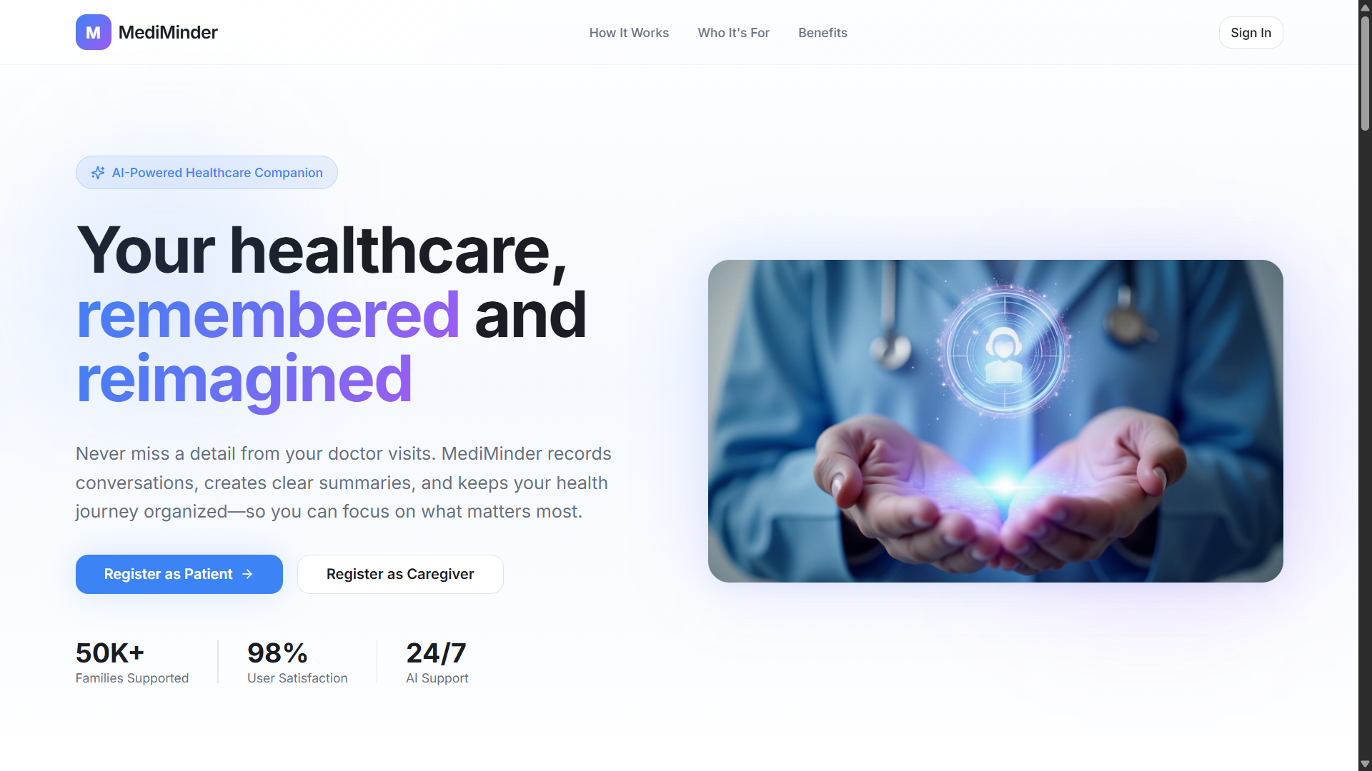
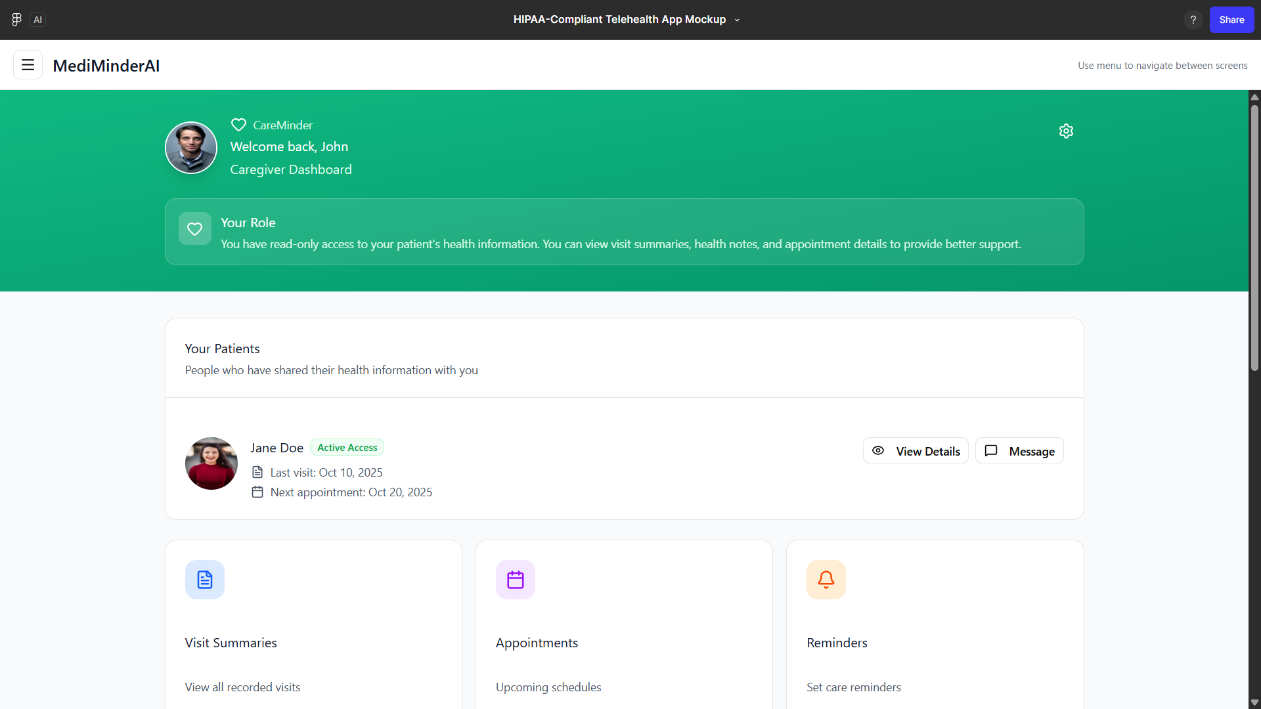
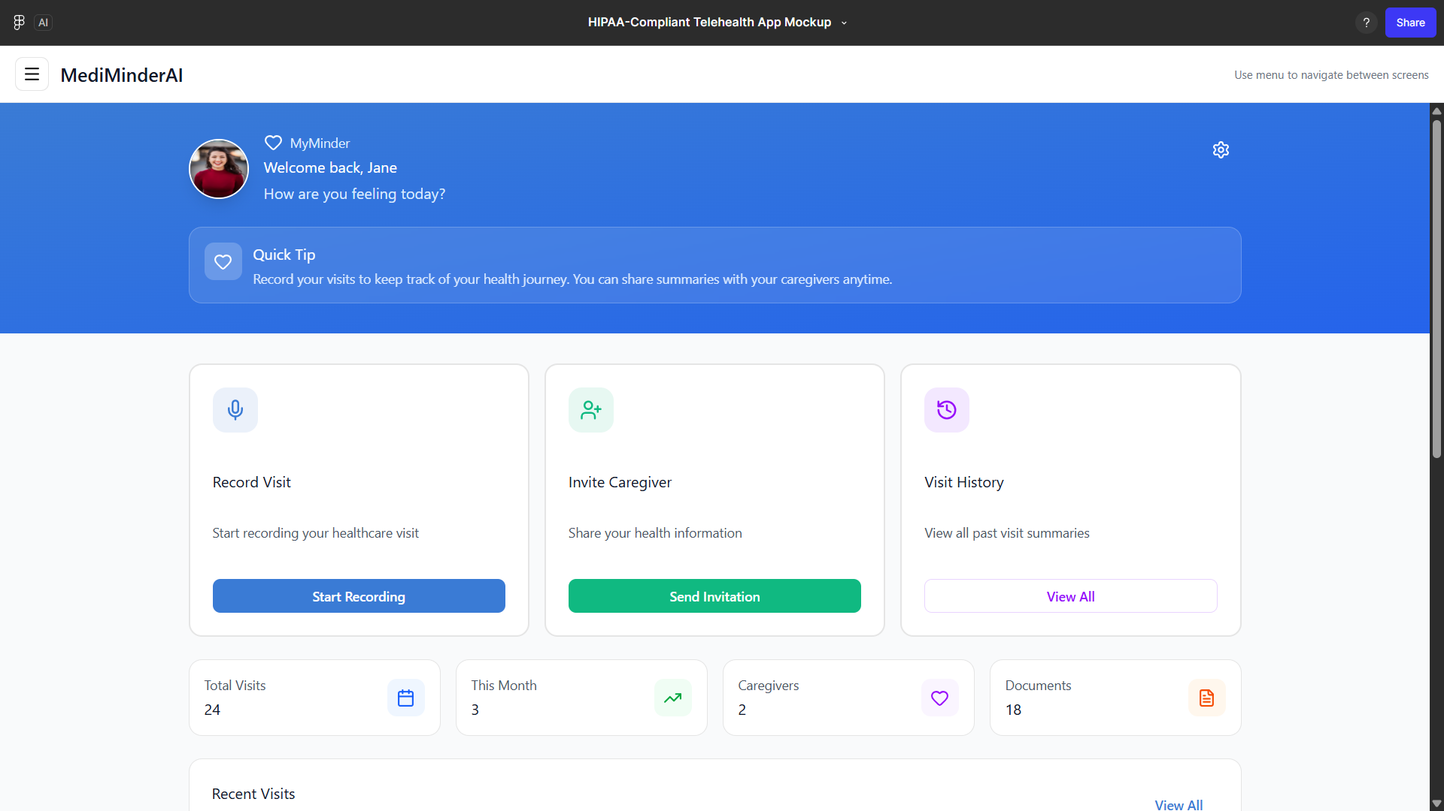
Goal
Cromwell’s Landing Page
Victor’s Patient & Caregiver Dashboards
+

Slide 3
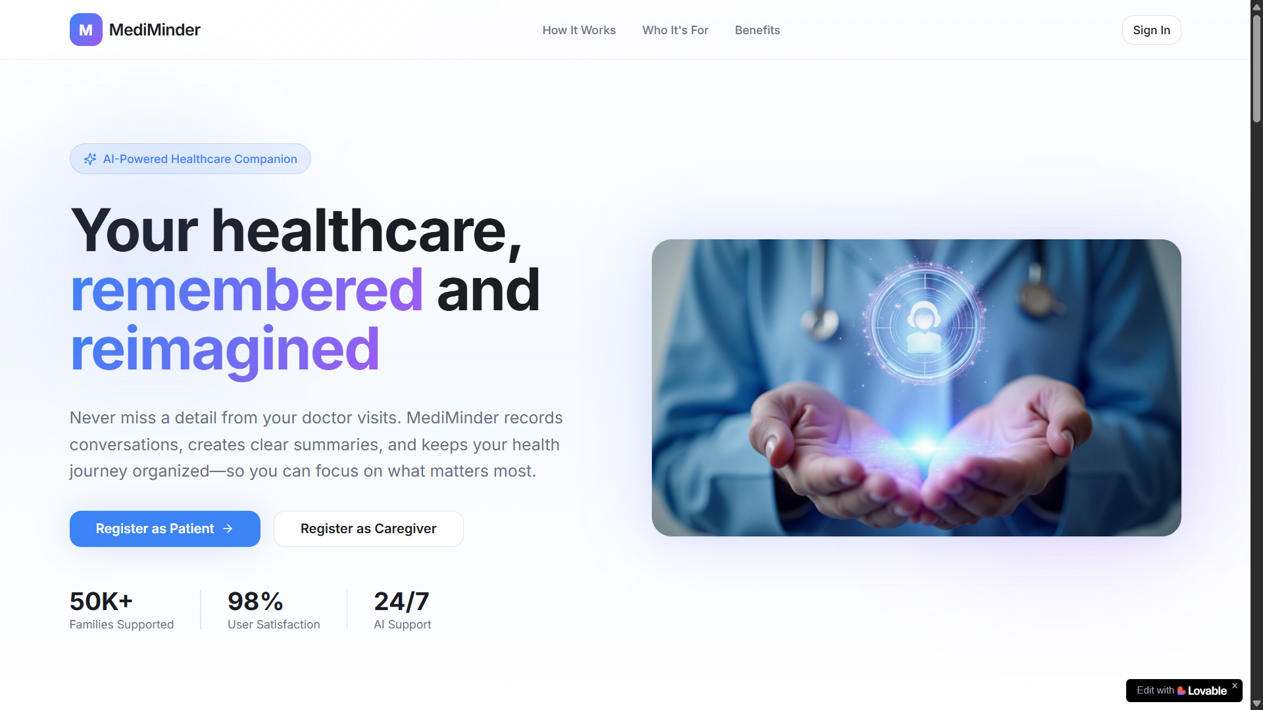
Landing Page 🟢
Use Cromwell’s design

Slide 4
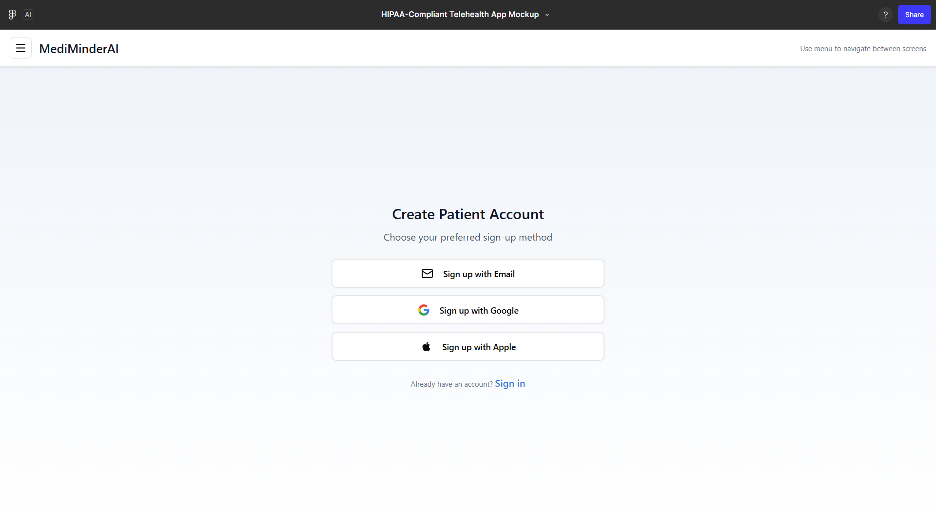
Onboarding & Sign-In 🟢
Use Victor’s design

Slide 5
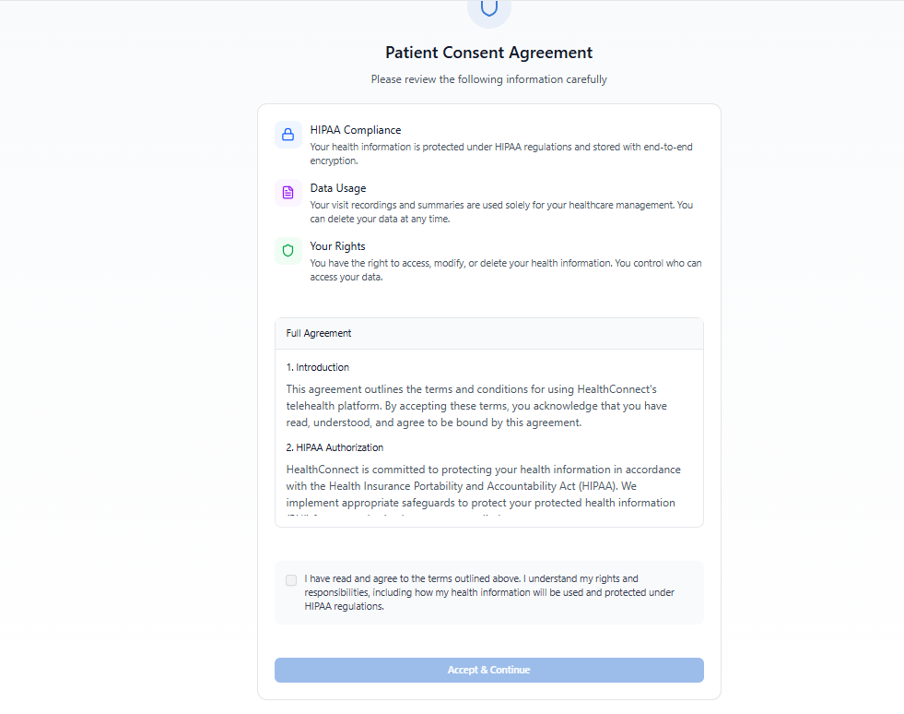
Patient Consent Page
Victor’s design page

Slide 6
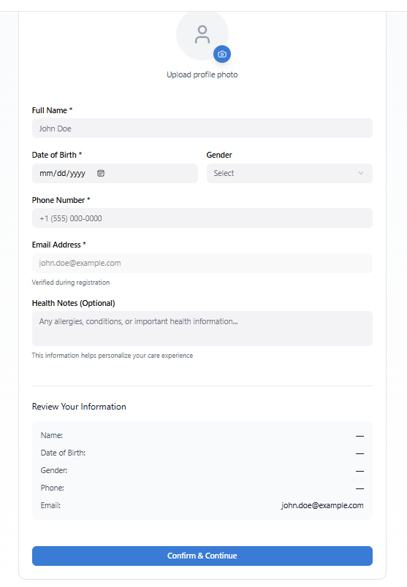
User Registration Page

Slide 7
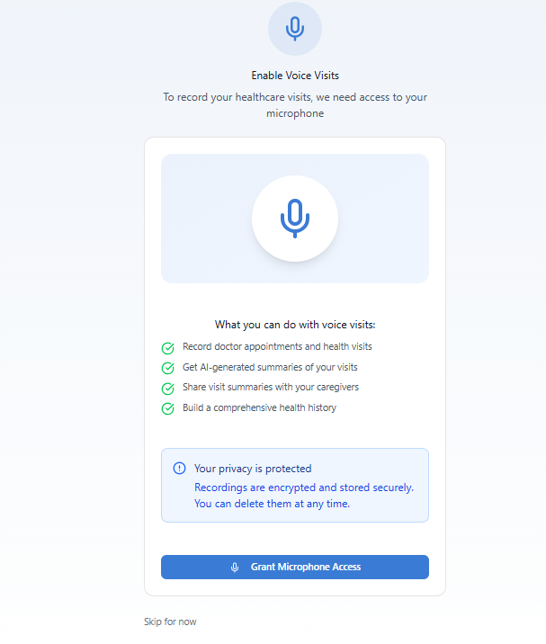
Enable Voice Visit

Slide 8
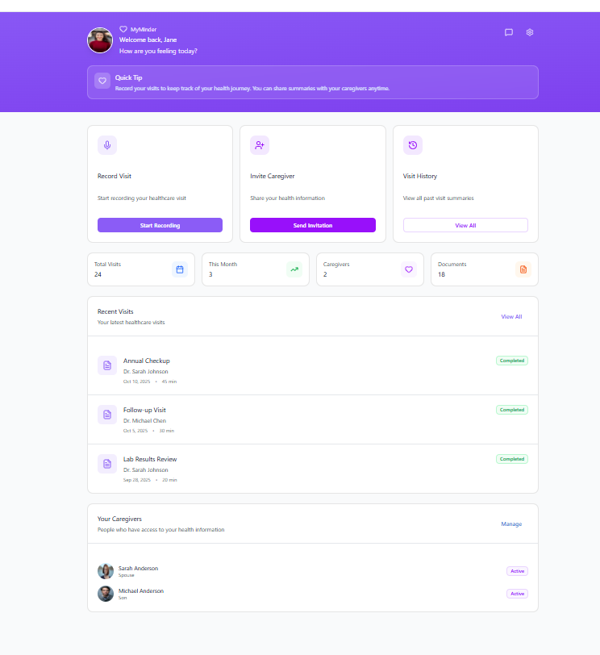
Patient Dashboard 🟡
In progress; use Victor’s design
Yes, and…
Needs to include Reminders, Symptom Journal, Suggested Questions, and Messages/Notes
Should actually be able to view history when clicking “View All”
Add basic Settings page with logout option
—Cromwell

Slide 9
Caregiver Registration
Click on Register as Caregiver from the Landing page.

Slide 10
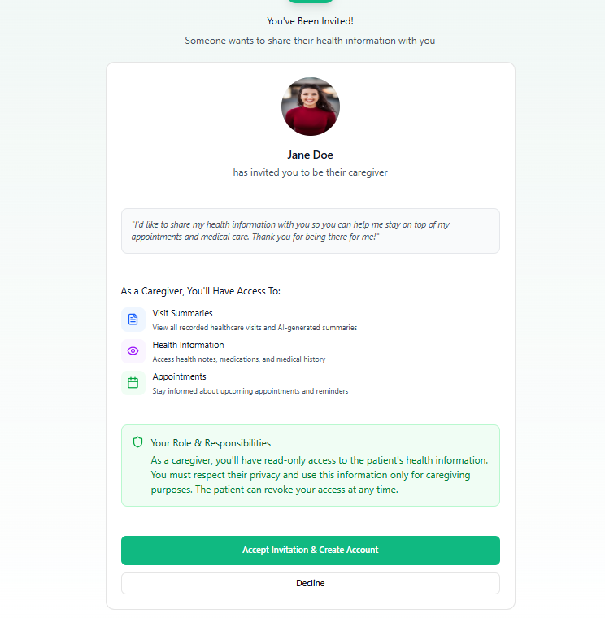
From Cromwell’s Landing page after user clicks on Register as caregiver, Caregiver will see invite from caregiver. Once accept invitation, only first time user will be directed to registration page after login with google/apple email.

Slide 11
Caregiver registration
Login with Google email

Slide 12
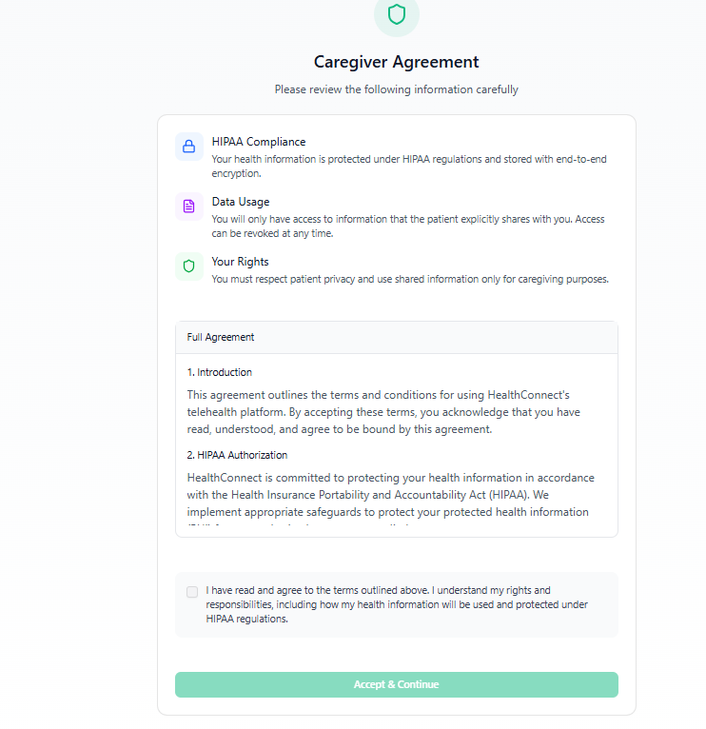
Caregiver Agreement

Slide 13
Caregiver completes registration
Victor’s design

Slide 14
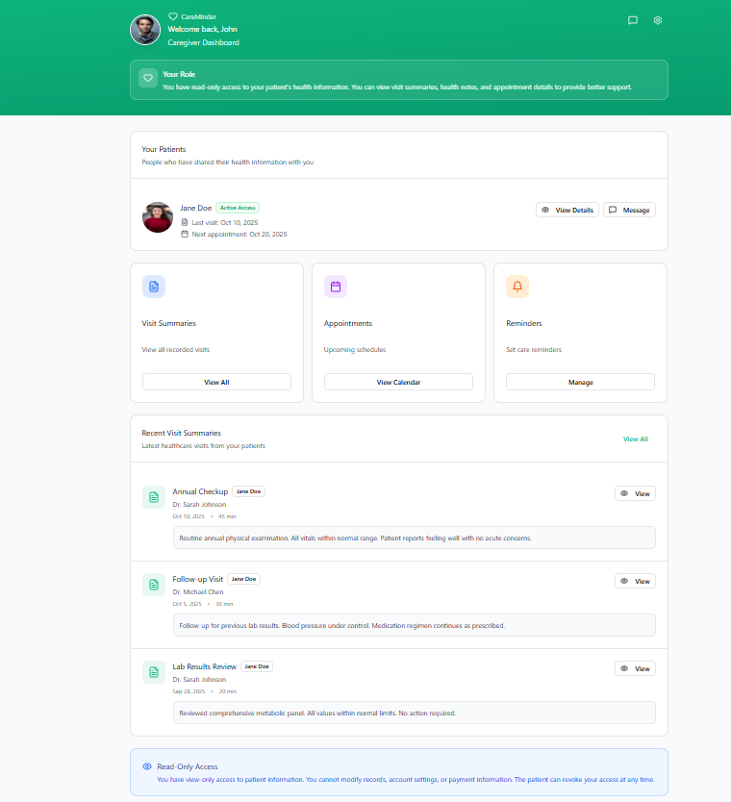
Caregiver Dashboard🟡
In progress; use Victor’s design
Yes, and…
Needs to include Messages
Should actually be able to click on the buttons to do something
Add basic Settings page with logout option
Consider replacing green color with purple to match my landing page design
—Cromwell

Slide 15
To-do List
Import Cromwell’s Landing Page into Victor’s Figma file*
Confirm list of approved features for Patient & Caregiver Dashboards*
Update Patient & Caregiver Dashboards accordingly
Coordinate with front-end engineers
Next Steps

Slide 16
References
Google Drive
MediMinder - PRD
MediMinder Product Scope and User Stories
MediMinderAI_MVP_Work_and_User_Stories_v2
MediMinderAI_Caregiver_Landing_Page_User Stories
MediMinderAI_MVP_Work_and_User_Stories_v2
Prototypes
Cromwell's Landing Page (Lovable)
Victor’s Dashboards (Figma)

Slide 17
Reminders

Slide 18
Reminders
Smart Reminders (appointments, meds, follow-ups)
Contextual nudges for meds, appointments, and follow-ups.
Why it matters: Generic reminders fail → users snooze and forget.
Die Hard twist:
Time/context-sensitive nudges (“Take meds with breakfast” vs. “Take pill now”).
Links back to visit summary (“Doctor said: track BP 2x daily – tap to log now”).

Slide 19
Reminders User Stories
As a Patient, I want to set reminders for medications or follow-ups.
AC: Reminders trigger notifications at the correct time.
As a Caregiver, I want to receive alerts when patient reminders are due.
AC: Caregiver notified of adherence tasks if enabled.

Slide 20
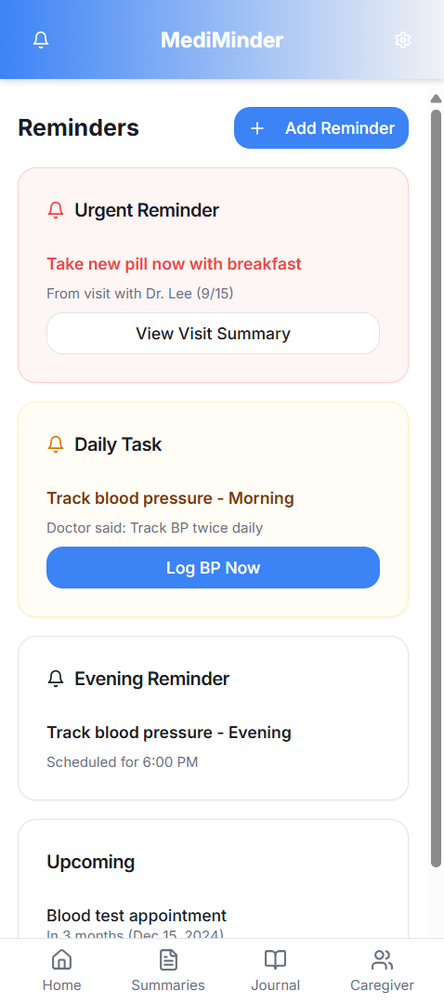
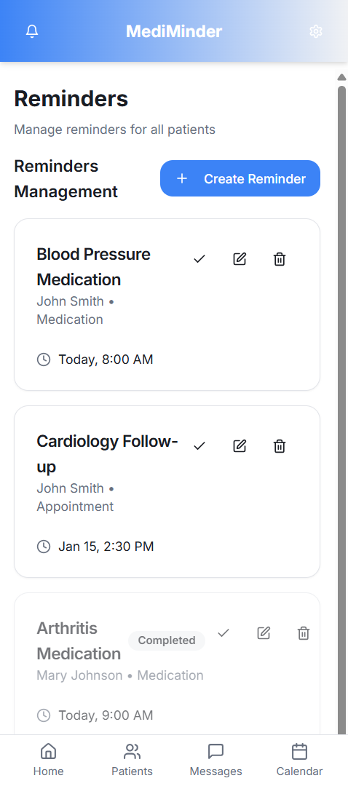
Reminders Example
Made by Cromwell
See here:
https://medi-minder-landing-page-v4.lovable.app/app
https://medi-minder-landing-page-v4.lovable.app/caregiver-app

Slide 21
Symptom Journal

Slide 22
Symptom Journal
Symptom Journal (daily/weekly input logging)
Tracks symptoms and health patterns.
Simple input tracking (symptoms, meds, lifestyle notes) → AI detects trends.
Why it matters: Users won’t journal unless they get value.
Die Hard twist:
Guided quick log (emoji sliders for pain, dropdown for symptoms).
AI connects dots: “You reported dizziness 3 times this week — mention to doctor.”

Slide 23
Symptom Journal User Stories
As a Patient, I want to log symptoms with a simple UI, so I can track my health over time.
AC1: Form allows entry of date, description, severity scale.
AC2: Recent entries displayed in dashboard quick-view.
As a Patient, I want to link symptom entries to visit summaries or recordings, so context is maintained.
AC1: Users can associate entries with visit ID.
AC2: Linked entries visible in both summary and symptom dashboard.

Slide 24
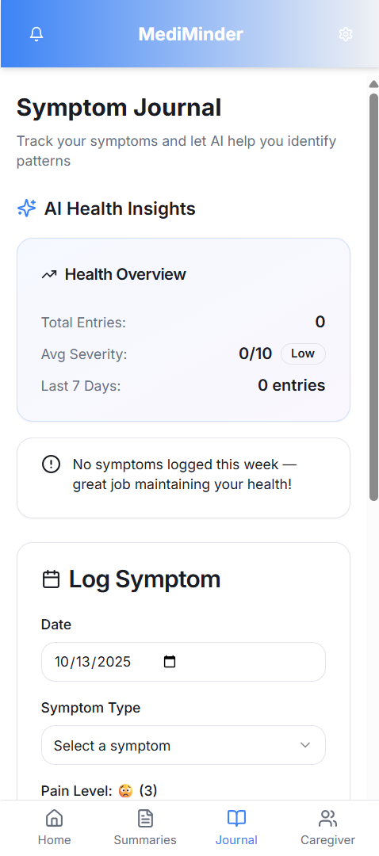
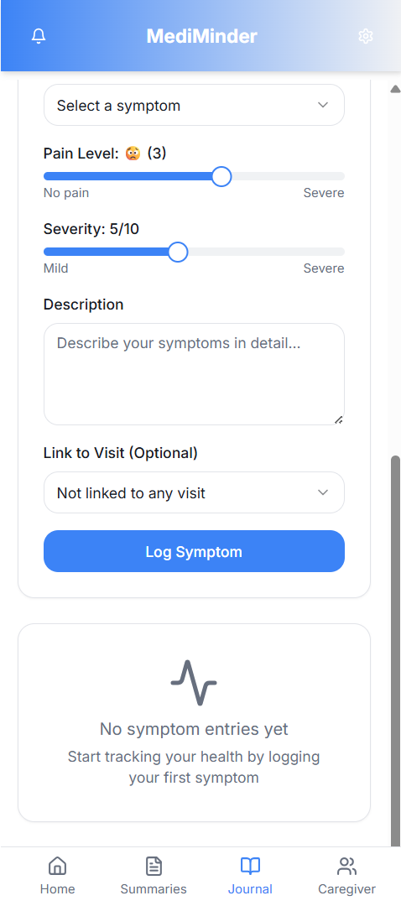
Symptom Journal EXample
Made by Cromwell
See here:
https://medi-minder-landing-page-v4.lovable.app/app

Slide 25
Suggested Questions

Slide 26
Suggested Questions
Suggested Questions (before/after visits)
AI recommends questions before and after appointments based on context.
Why it matters: 70% leave with unasked questions.
Die Hard twist:
Before visit: Suggests questions from condition history (“Ask about side effects of increasing dosage”).
After visit: Generates clarifications from the summary (“Doctor said blood test — ask when results will be available”).

Slide 27
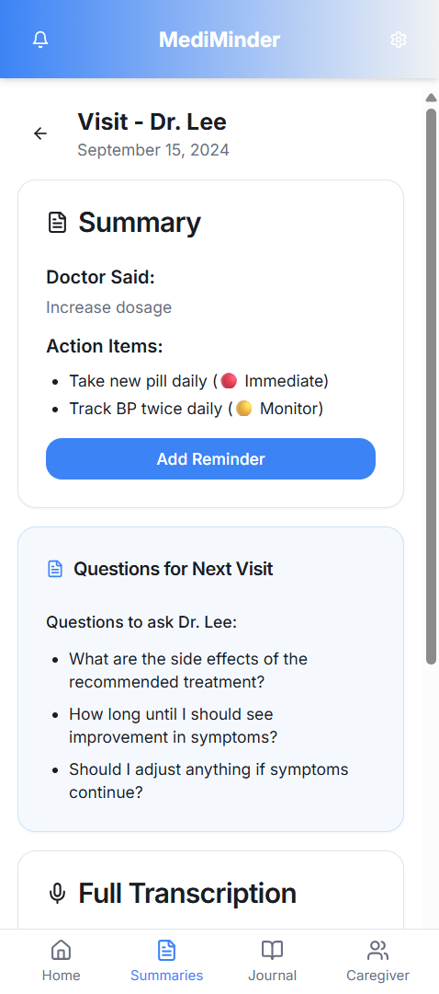
Suggested Questions Example
Made by Cromwell
See here:
https://medi-minder-landing-page-v4.lovable.app/app

Slide 28
Messages/Notes

Slide 29
Messages/Notes
Secure communication log for contextual notes visible within care scope.
Text box for comments, activity feed, visibility toggle (private/shared).
Caregiver Workflow:
Add notes or messages
Entry saved securely and time-stamped.
Improves coordination and follow-up quality.

Slide 30
Messages/Notes User Stories
As a Caregiver, I want to add private notes per visit or reminder, so I can track care coordination efforts.
AC: Notes stored securely with patient and caregiver ID; visible only to authorized participants.
As a Caregiver, I want to message or leave notes for the patient or co-caregivers, so communication remains contextual.
AC: Message threads stored per visit/reminder; visibility limited to authorized caregivers and patients.

Slide 31
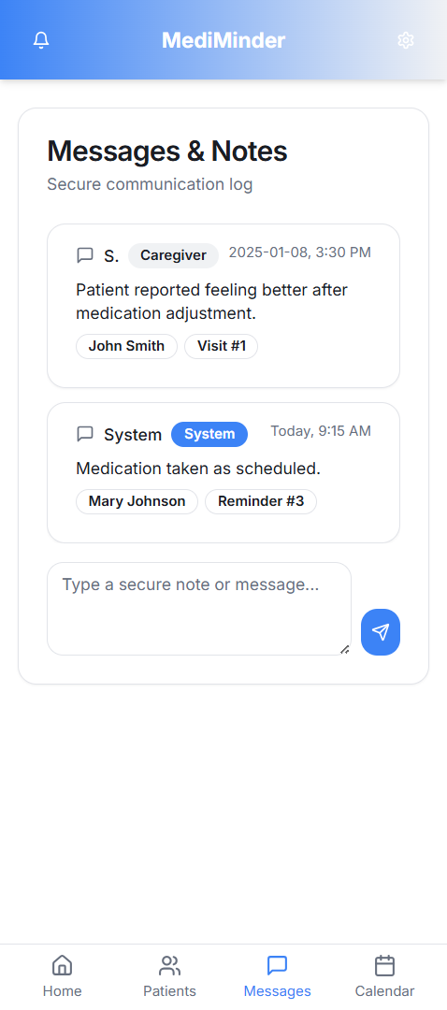
Messages/Notes Example
Made by Cromwell
See here:
https://medi-minder-landing-page-v4.lovable.app/caregiver-app

Slide 32
Settings

Slide 33
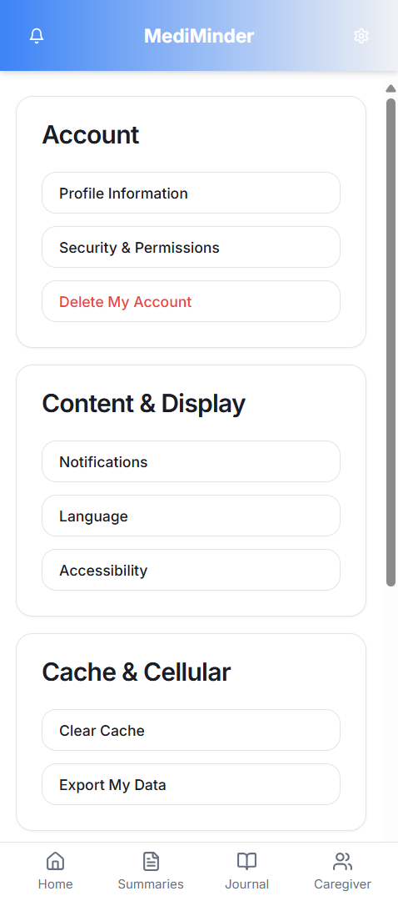
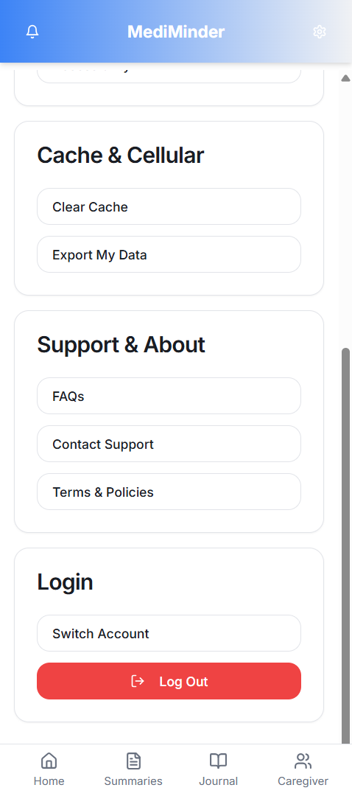
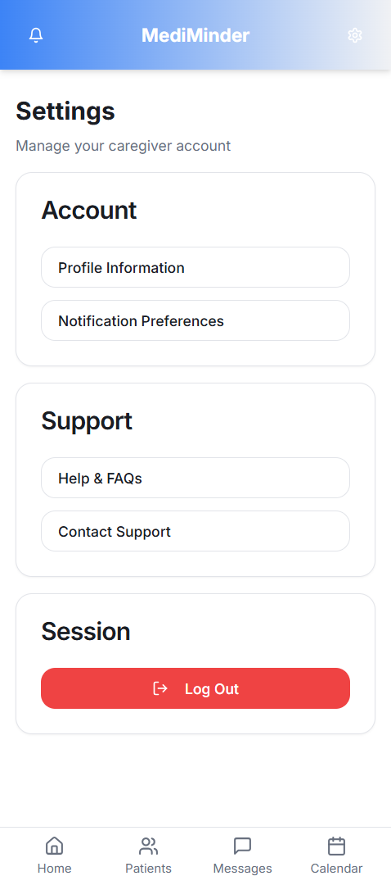
Settings Example
Made by Cromwell
See here:
https://medi-minder-landing-page-v4.lovable.app/app
https://medi-minder-landing-page-v4.lovable.app/caregiver-app

